Slide 1
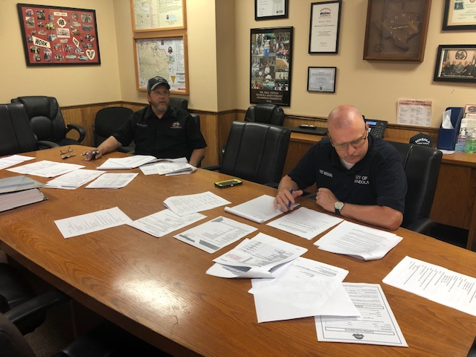
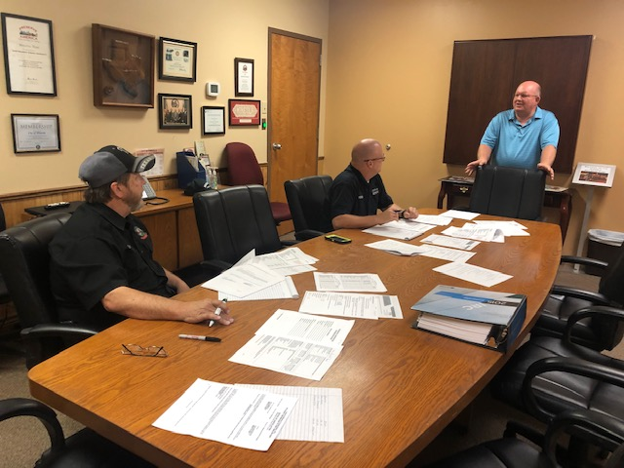
Teamwork!
Mayor stopping by to check on the progress of our research
David and Curt spent two days researching permit fees, one full day locked away in the conference room

